Slide 1
Periodic Relationships Among the Elements Chapter 8 Dr. Sultana Bedoura

Slide 2
Lecture Plan
Development of the Periodic Table
Ground state electron configurations
Free elements in chemical equations
Valence and core electrons
Metallic character
Isoelectronic atom, cation and anion
Effective nuclear charge
Atomic radii and ionic radii
Ionization energies
Electron affinity
Diagonal relationship
Periodic properties of the elements

Slide 3
Development of the Periodic Table
The Periodic Table
During the time of Robert Boyle (1661) only 13 elements were known
(Sb, As, Bi, C, Cu, Au, Fe, Pb, Hg, Ag, S, Sn and Zn)
By the end of the eighteenth century Lavoisier added another 11 elements
(Cl, Co, H, Mn, Mo, Ni, N, O, P, Pt and W)
Since that time, a new element has been discovered on the average of every two and one-half years

Slide 4
Development of the Periodic Table
With the increase of element number, Scientists began to find patterns in their properties. In 1829, J.W. Dobereiner discovered the existence of families of three elements with similar chemical properties and called them triads
Li, Na, K Ca, Sr, Ba S, Se, Te Cl, Br, I and Mn, Cr, Fe
In 1865, Newlands arranged the elements in order of increasing atomic weights. He placed seven elements in a group and every eighth element had similar properties. Known as law of octaves
But he left no room for any newer elements

Slide 5
Development of the Periodic Table
In 1871 Mendeleeff proposed his version of the periodic table in which elements were arranged in order of increasing atomic weights
He grouped the elements on the basis of similarities in their chemical properties.
His table had blank spaces where he predicted the discovery of 10 other elements.
More than 700 versions of the periodic table were proposed since then.

Slide 6
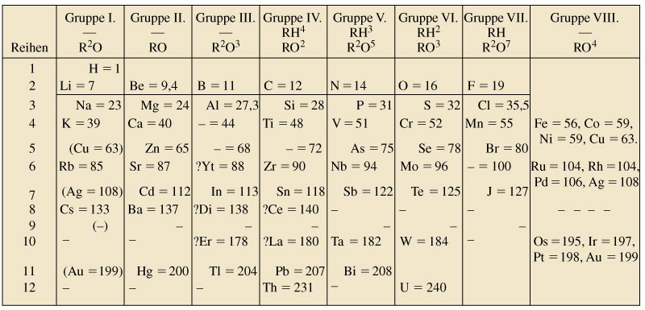
Mendeleev’s Periodic Table
1871
— = 44
— = 68
— = 72
— =100
Notes:
Mendeleev’s work attracted more attention
He left blank spaces in his table, at 44, 68, 72, and 100, for undiscovered elements (Sc Ga Ge Tc)
He corrected some atomic mass values (In, U).
Group 1 has high molar volume, low melting points and all form M⁺ ions.

Slide 7
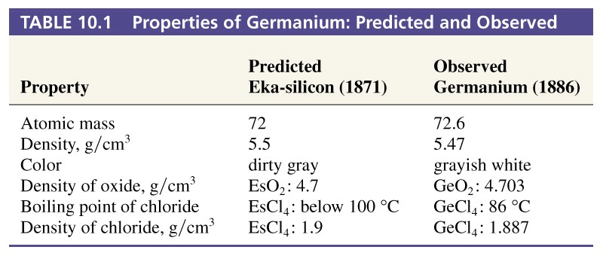
Predicted Elements were Found
Properties of Germanium: Predicted and Observed
Notes:
Other additions to the table included the Noble gases discoved by William Ramsey.
Mendeleev placed certain elements out of order-he assumed that errors had been made in the atomic masses, but it is clear that some elements remain out of order. Moseley changed that with x-ray spectra.

Slide 8
Development of the Periodic Table
The most popular version of the periodic table shows the elements arranged in order of increasing atomic number and grouped into periods and groups
Each group contains elements with similar chemical properties
In most cases, the elements in a column also have similar electronic configuration
The two most important exceptions are hydrogen and helium

Slide 9
Development of the Periodic Table
The periodic table provides a basis for predicting general trends in a number of physical properties, including
the relative size of atoms and the ions they form, and
the relative ease with which atoms either gain or lose electrons.
These properties, such as:
the size of the atoms or the ions,
ionization energies,
electron affinity,
electronegativities etc.
profoundly influence the chemical behavior of elements

Slide 10
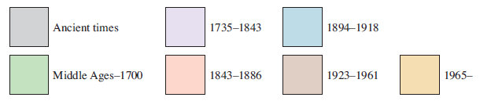
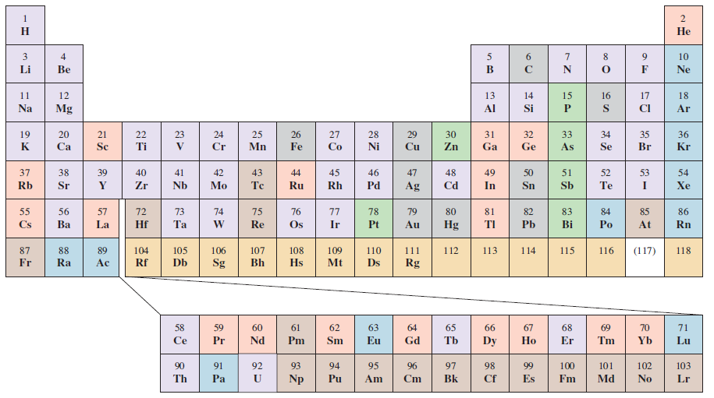
When the Elements Were Discovered

Slide 11
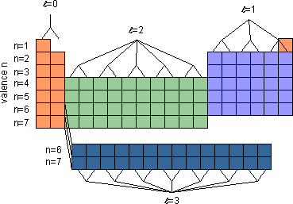
Outermost subshell electron quantum numbers

Slide 12
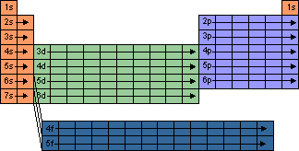
Outermost subshell being filled with e⁻

Slide 13
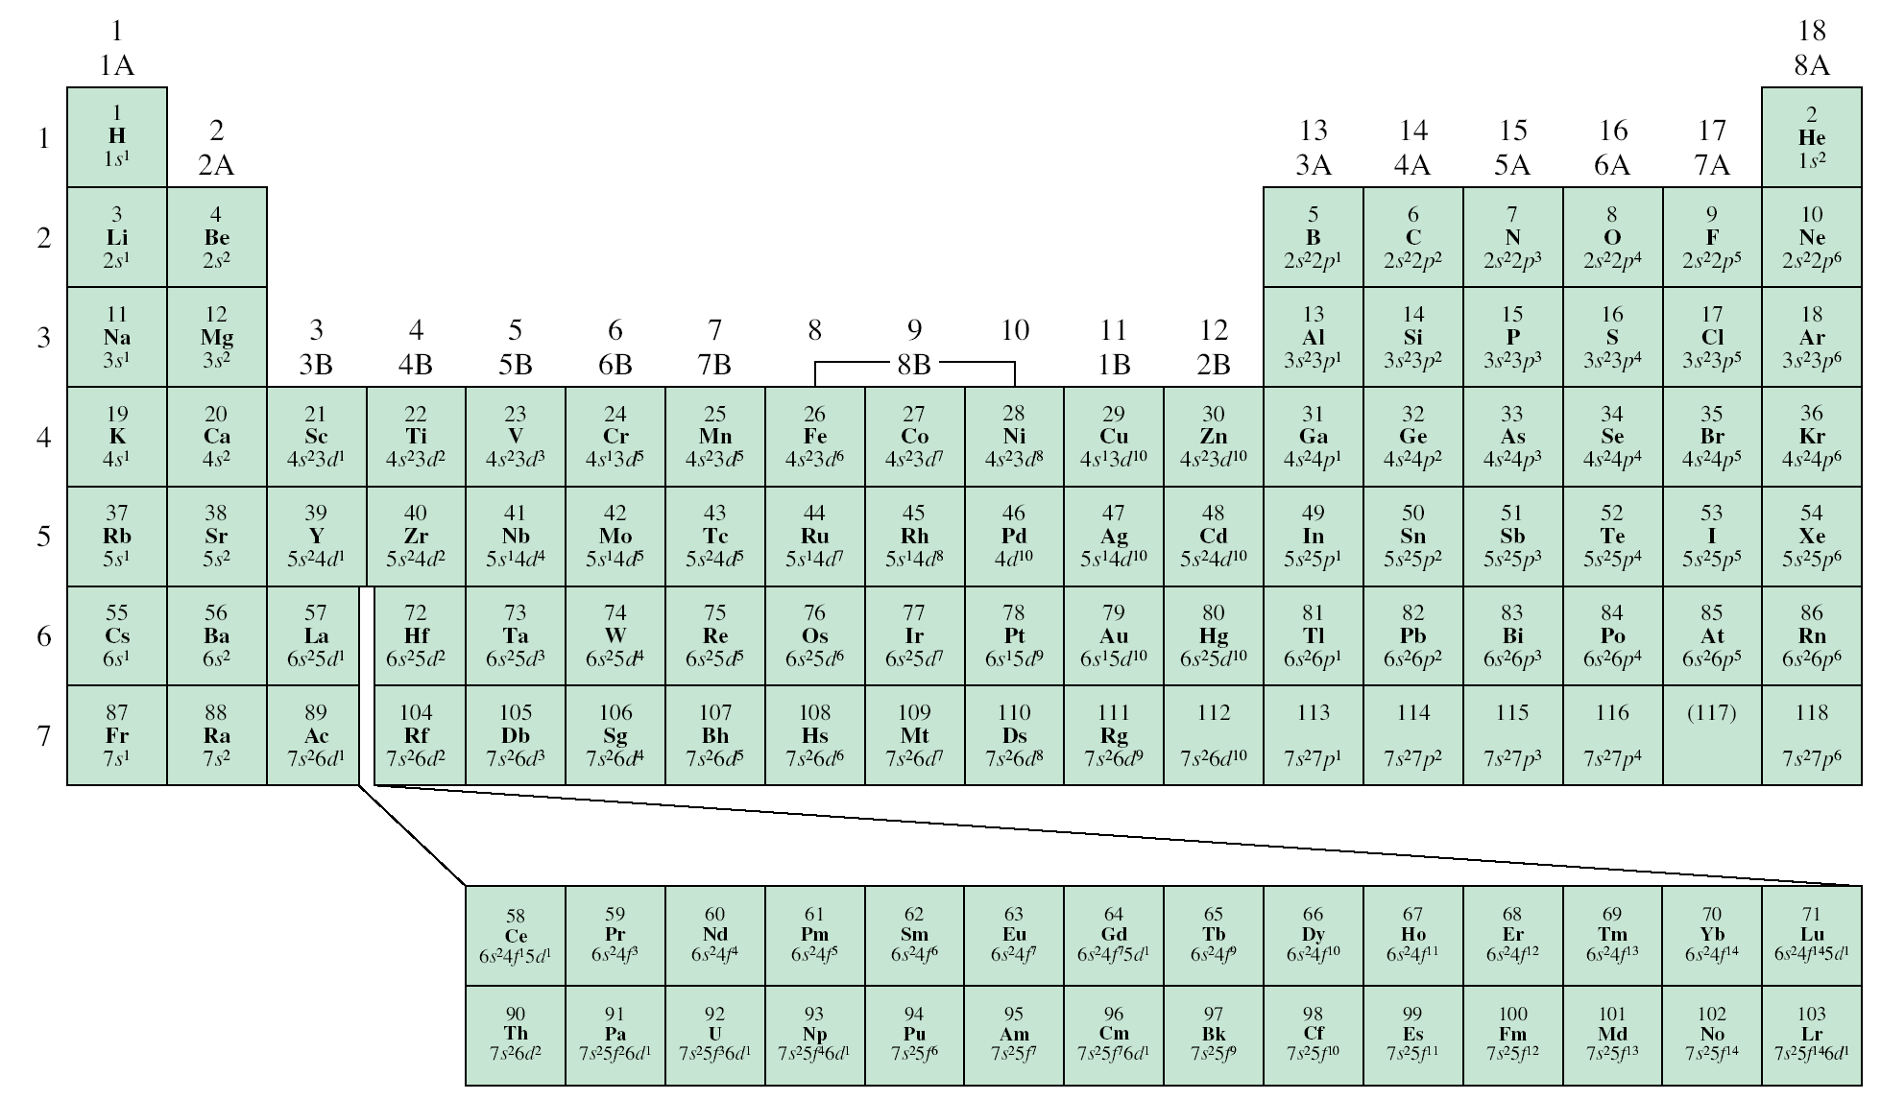
Ground State Electron Configurations
ns¹
ns²np⁶
ns²np¹
ns²np²
ns²np³
ns²np⁴
ns²np⁵
ns²
d¹
d⁵
d¹⁰
4f
5f

Slide 14
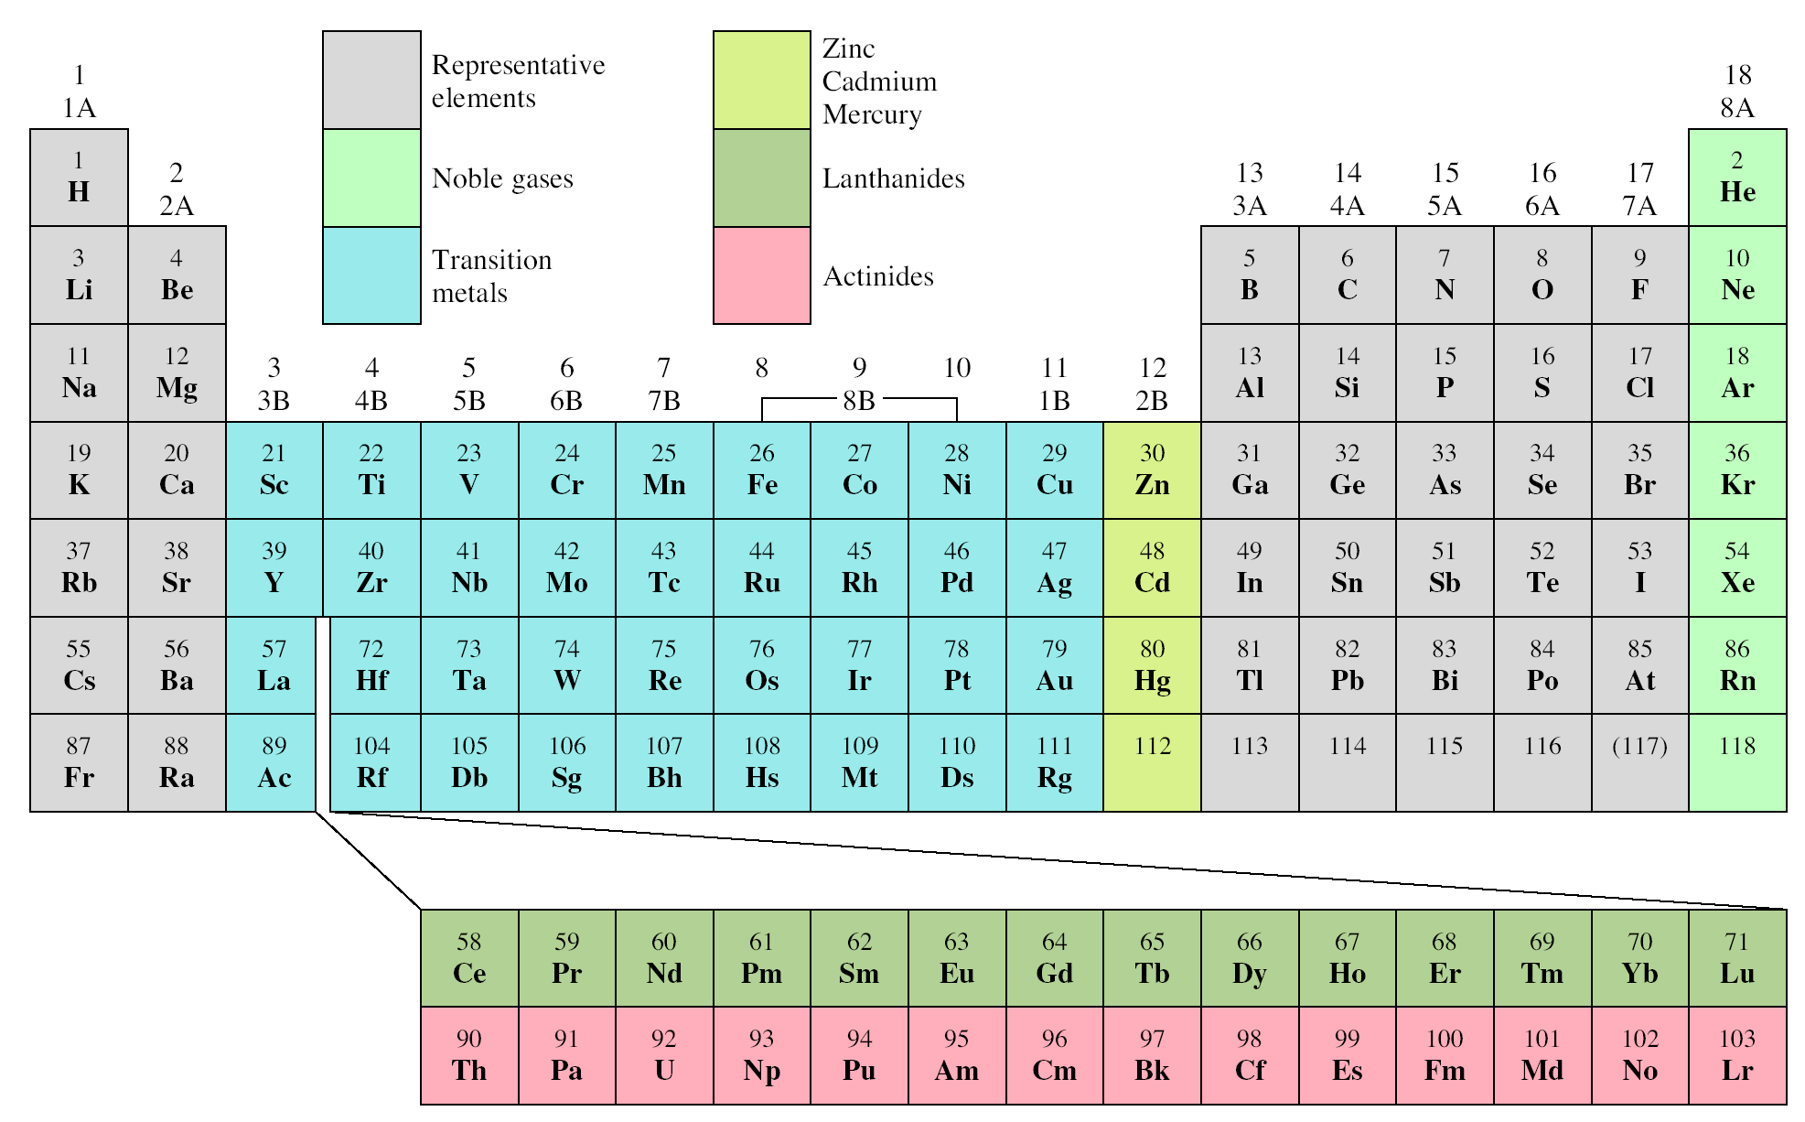
Classification of the Elements

Slide 15
Free Elements in Chemical Equations
How metals, metalloids, and nonmetals are represented as free elements in chemical equations?
Metals do not exist in discrete molecular units, empirical formulas are used.
Empirical formula = Symbols (Mg, Ca, Fe, Cu, Zn, etc.)
For nonmetals no single rule.
Carbon exists as an extensive three-dimensional network of atoms, empirical formula (C) is used.
Hydrogen, nitrogen, oxygen, & halogens exists as diatomic molecule, molecular formula, H₂, N₂, O₂, & F₂, Cl₂, Br₂, I₂ are used.
Stable form of molecular phosphorus P₄ is used

Slide 16
Free Elements in Chemical Equations
For nonmetals no single rule. (contd.)
Stable form of molecular sulfur, S₈ but (S) is used. Combustion of sulfur:
S₈(s) + 8O₂(g) → 8SO₂(g)
S(s) + O₂(g) → SO₂(g)
All noble gases are monatomic, symbols are used.
He, Ne, Ar, Kr, Xe, & Rn
Metalloids have complex three-dimensional networks, empirical formulas are used,
B, Si, Ge, As, Sb, Po, & At
Identical
stoichiometry

Slide 17
Valence & Core Electrons
The electrons in all the subshells with the highest principal energy shell are called the valence electrons
Electrons in lower energy shells are called core electrons
Chemists have observed that one of the most important factors in the way an atom behaves, both chemically and physically, is the number of valence electrons
Example:
Rb = 37 electrons = 1s²2s²2p⁶3s²3p⁶4s²3d¹⁰4p⁶5s¹
the highest principal energy shell of Rb that contains electrons is the 5th, therefore Rb has 1 valence electron and 36 core electrons
Kr = 36 electrons = 1s²2s²2p⁶3s²3p⁶4s²3d¹⁰4p⁶ ?
Notes:
Kr has 8 valence electrons and 28 core electrons

Slide 18
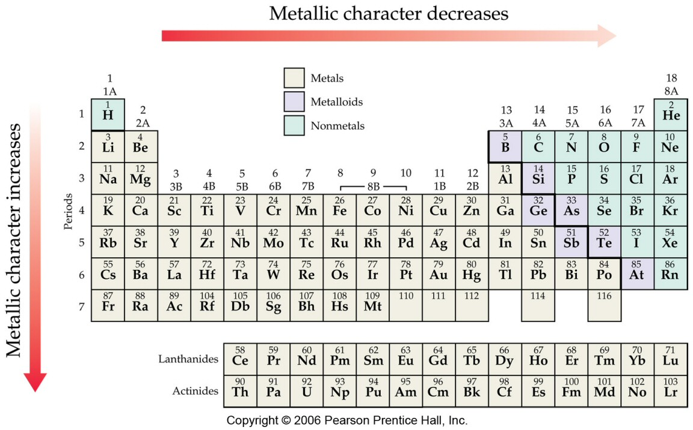
Trends in Metallic Character

Slide 19
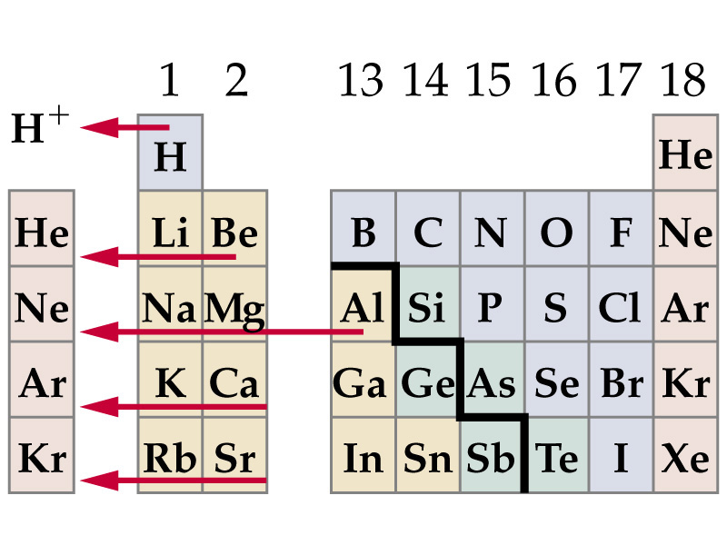
Metals Tend to Lose Electrons

Slide 20
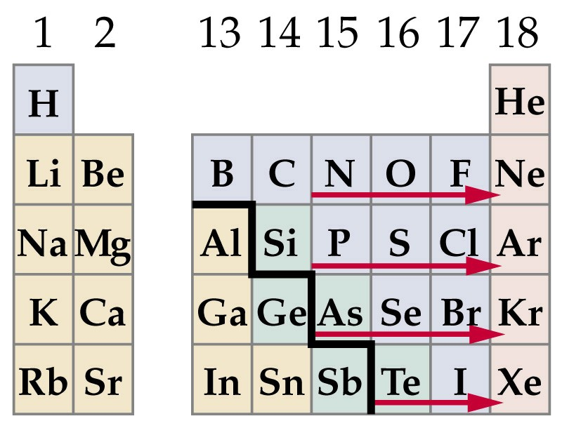
Nonmetals Tend to Gain Electrons

Slide 21

Cations and Anions of Elements
+1
+2
+3
-3
-2
-1

Slide 22
Electron Configurations of Cations of Transition Metals
When a cation is formed from an atom of a transition metal, electrons are always removed first from the ns orbital and then from the (n – 1)d orbitals
Fe: [Ar]4s²3d⁶
Mn: [Ar]4s²3d⁵
Fe²⁺: [Ar]4s⁰3d⁶ or [Ar]3d⁶
Mn²⁺: [Ar]4s⁰3d⁵ or [Ar]3d⁵
Fe³⁺: [Ar]4s⁰3d⁵ or [Ar]3d⁵

Slide 23
Effective Nuclear Charge (Z_{eff})
Effective nuclear charge (Z_{eff}) is the “positive charge” felt by valence electron in a multi-electron atom
Z_{eff} = Z – σ 0 < σ < Ζ (σ = shielding constant)
Z_{eff} ≈ Z – number of inner or core electrons
Z
Core
Z_{eff}
Radius (pm)
Na
11
10
1
186
Mg
12
10
2
160
Al
13
10
3
143
Si
14
10
4
132

Slide 24
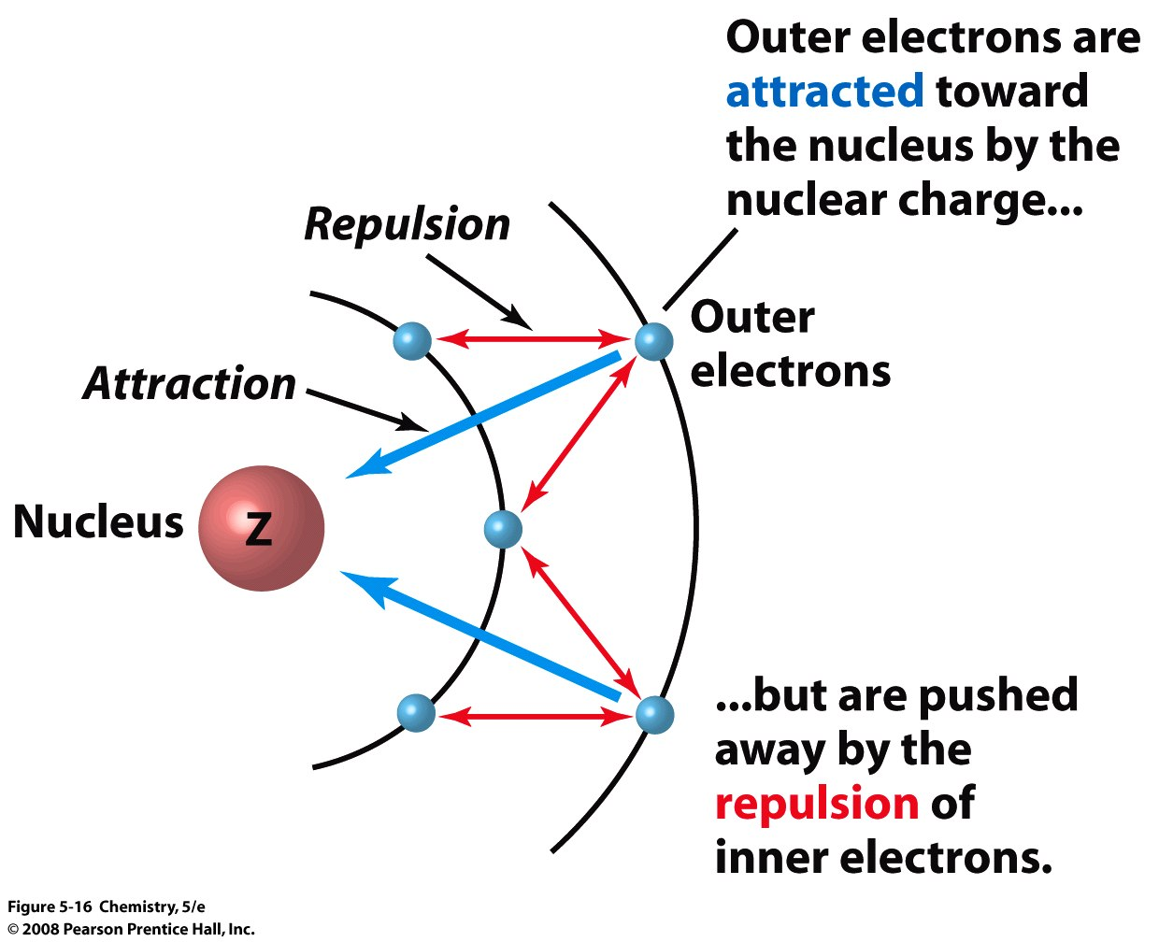
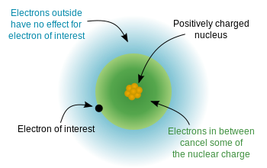
Effective Nuclear Charge (Z_{eff})
Z_{eff} = Z_{actual} – No. of Core Electrons or Electron shielding

Slide 25
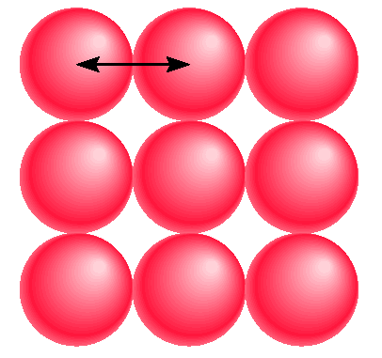
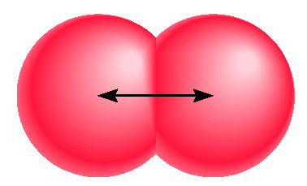
Atomic Radii
metallic radius
covalent radius

Slide 26
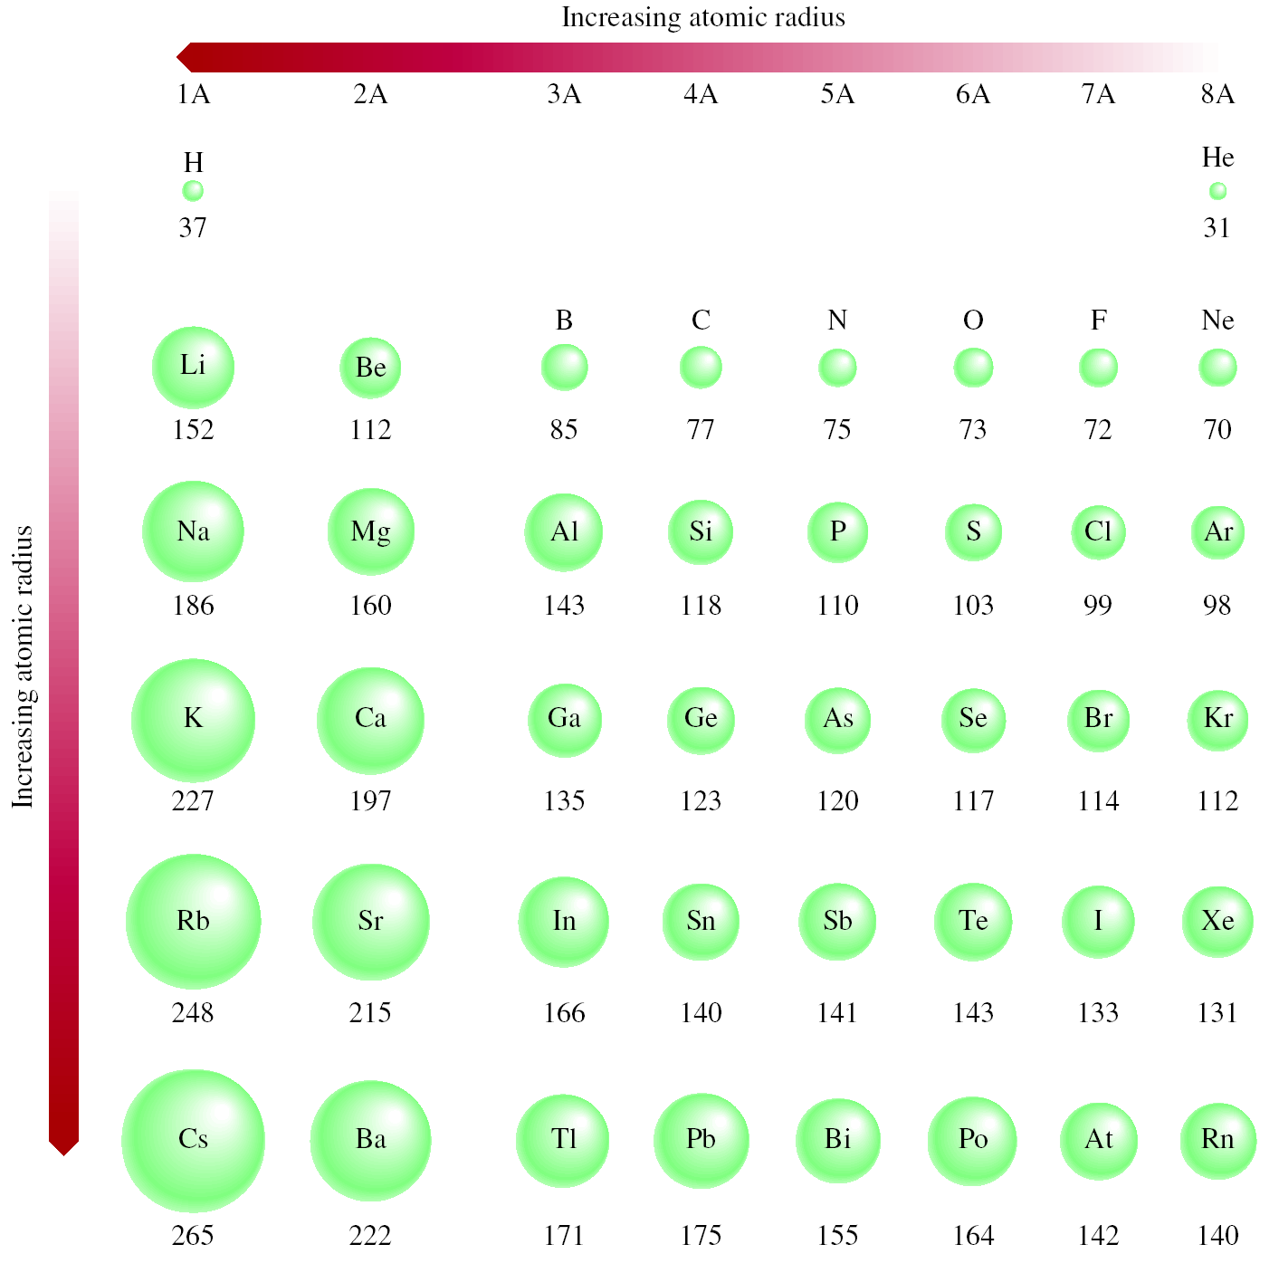
Atomic Radii

Slide 27
Atomic Radii Increases Down the Group
Group IIA
2e⁻
2e⁻
Be
Mg
Ca
Sr
Ba
Ra
Be (4p⁺ & 4e⁻)
4 p⁺
2e⁻
8e⁻
Mg (12p⁺ & 12e⁻)
2e⁻
12 p⁺
2e⁻
8e⁻
Ca (20p⁺ & 20e⁻)
8e⁻
2e⁻
20 p⁺

Slide 28
Atomic radii decreases across the Period
Period 2
Li | Be | B | C | N | O
1e⁻
2e⁻
3e⁻
2e⁻
2e⁻
2e⁻
3 p⁺
4 p⁺
5 p⁺
Li (3p⁺ & 3e⁻)
Be (4p⁺ & 4e⁻)
B (5p⁺ & 5e⁻)
4e⁻
6e⁻
8e⁻
2e⁻
2e⁻
2e⁻
6 p⁺
8 p⁺
10 p⁺
C (6p⁺ & 6e⁻)
O (8p⁺ & 8e⁻)
Ne (10p⁺ & 10e⁻)

Slide 29
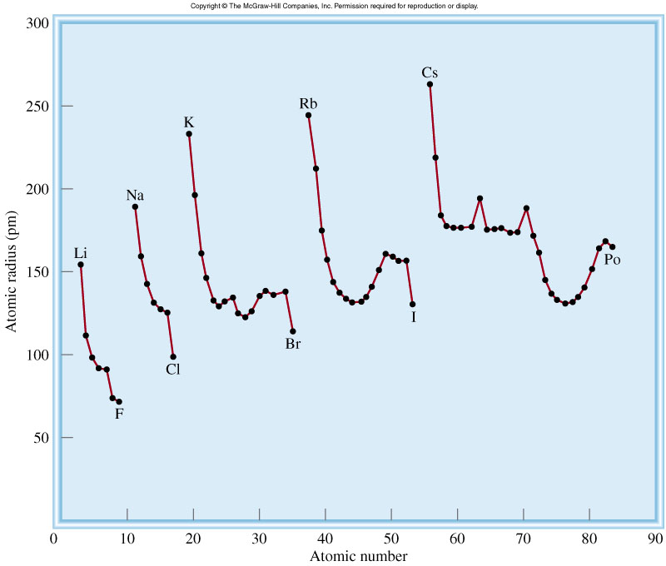
Trends in Atomic Radii

Slide 30
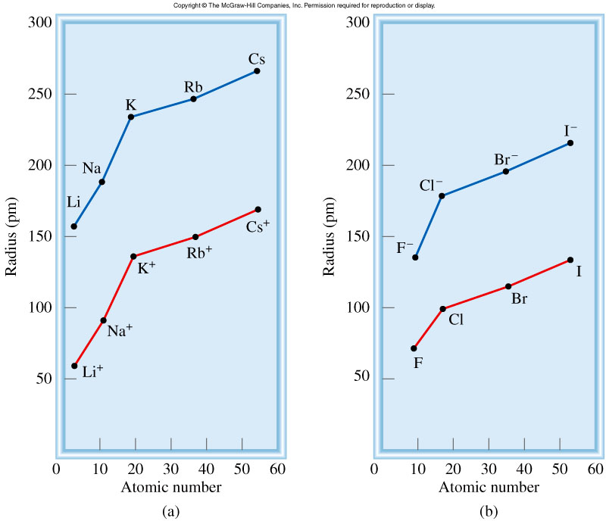
Comparison of atomic radii with ionic radii
Notes:
If the
atom forms an anion, its size (or radius) increases, because the nuclear charge remains
the same but the repulsion resulting from the additional electron(s) enlarges the
domain of the electron cloud. On the other hand, removing one or more electrons
from an atom reduces electron-electron repulsion but the nuclear charge remains the
same, so the electron cloud shrinks, and the cation is smaller than the atom.

Slide 31
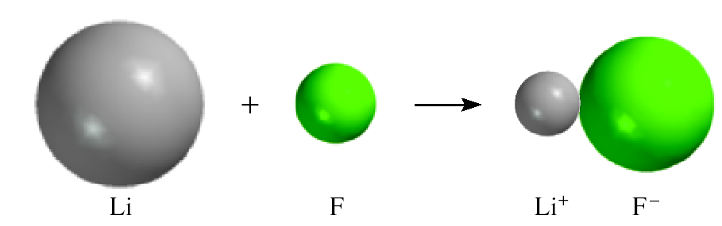
Atomic Radii & Ionic Radii
Cation is always smaller than atom from which it is formed
Anion is always larger than atom from which it is formed

Slide 32
Electron Configurations of cation-anions
Isoelectronic: have the same number of electrons, and hence the same ground-state electron configuration
Ne(10): 1s²2s²2p⁶
Na(11): 1s²2s²2p⁶3s¹ Na⁺(10) : 1s²2s²2p⁶ or [Ne]
Al(13) : 1s²2s²2p⁶3s²3p¹ Al³⁺(10): 1s²2s²2p⁶ or [Ne]
F(9) : 1s²2s²2p⁵ F⁻(10) : 1s²2s²2p⁶ or [Ne]
O(8) : 1s²2s²2p⁴ O²⁻(10) : 1s²2s²2p⁶ or [Ne]
N(7) : 1s²2s²2p⁵ N³⁻(10) : 1s²2s²2p⁶ or [Ne]
Na⁺, Al³⁺, F⁻, O²⁻, and N³⁻ are all isoelectronic with Ne
What neutral atom is isoelectronic with H⁻ ?
H⁻: 1s² same electron configuration as He

Slide 33
Radii for Isoelectronic atoms or ions
Atom or Ion Radius (nm) Electron configuration
C⁴⁻ 0.260 1s²2s²2p⁶
N³⁻ 0.171 1s²2s²2p⁶
O⁻² 0.140 1s²2s²2p⁶
F⁻ 0.136 1s²2s²2p⁶
Ne 0.112 1s²2s²2p⁶
Na⁺ 0.095 1s²2s²2p⁶
Mg²⁺ 0.065 1s²2s²2p⁶
Al³⁺ 0.050 1s²2s²2p⁶
Notes:
Atom or Ion Radius (nm) Electron config.
C⁴⁻ 0.260 1s²2s²2p⁶
N³⁻ 0.171 1s²2s²2p⁶
O⁻² 0.140 1s²2s²2p⁶
F⁻ 0.136 1s²2s²2p⁶
Ne 0.112 1s²2s²2p⁶
Na⁺ 0.095 1s²2s²2p⁶
Mg²⁺ 0.065 1s²2s²2p⁶
Al³⁺ 0.050 1s²2s²2p⁶

Slide 34
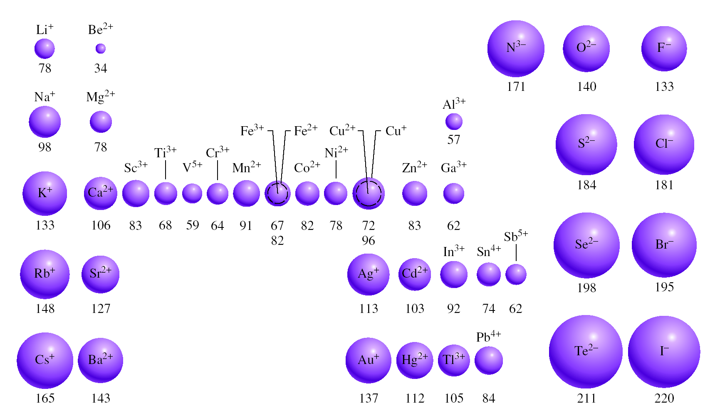
The Radii (in pm) of Ions of Elements

Slide 35
Ionization Energy
Ionization energy:
The minimum energy (kJ/mol) required to remove an electron from a gaseous atom in its ground state
I₁ + X _{(g)} X⁺_{(g)} + e⁻
I₁ first ionization energy
I₂ + X⁺_{(g)} X²⁺_{(g)} + e⁻
I₂ second ionization energy
I₃ + X²⁺_{(g)} X³⁺_{(g)} + e⁻
I₃ third ionization energy
I₁ < I₂ < I₃

Slide 36
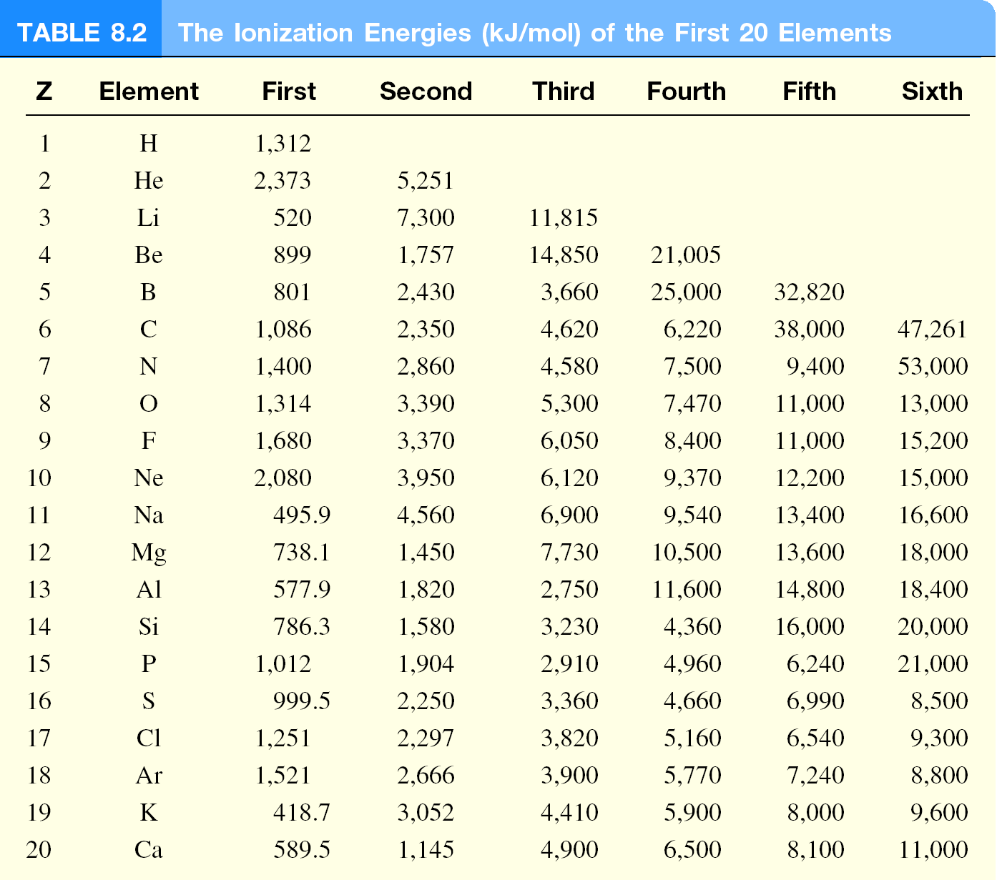
Ionization Energy
The Ionization Energies (kJ/mol) of the Elements

Slide 37
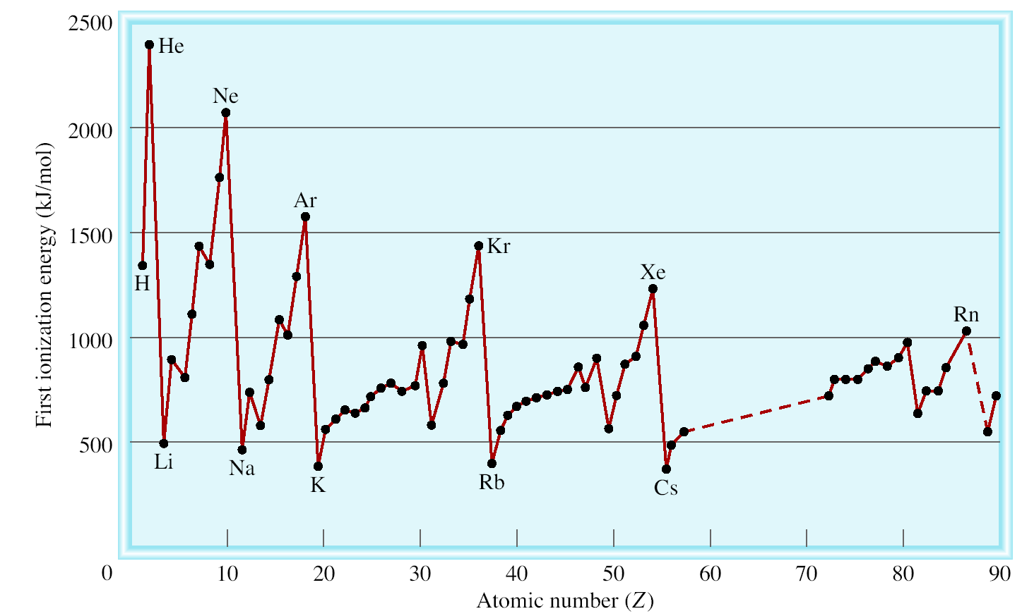
First ionization energy vs atomic number
Filled n=1 shell
Filled n=2 shell
Filled n=3 shell
Filled n=4 shell
Filled n=5 shell

Slide 38
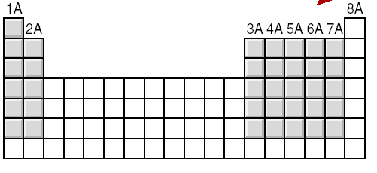
General trends in first ionization energies
Increasing First Ionization Energy
Increasing First Ionization Energy

Slide 39
Electron Affinity
Electron affinity :
The negative of the energy change that occurs when an electron is accepted by an atom in the gaseous state to form an anion
EA of O⁻ is highly –ve; i.e. O²⁻ formation is unfavorable,
electron-electron repulsion (g) > stability from noble gas configuration
O²⁻ ion stabilized by neighboring cation, e.g. Li₂O, Mg₂O
X _{(g)} + e⁻ X⁻_{(g)}
F _{(g)} + e⁻ F⁻_{(g)}
ΔH = −328 kJ/mol
EA = +328 kJ/mol
O _{(g)} + e⁻ O⁻_{(g)}
ΔH = −141 kJ/mol
EA = +141 kJ/mol
ΔH = +780 kJ/mol
?
O⁻ _{(g)} + e⁻ O²⁻_{(g)}
EA = −780 kJ/mol

Slide 40
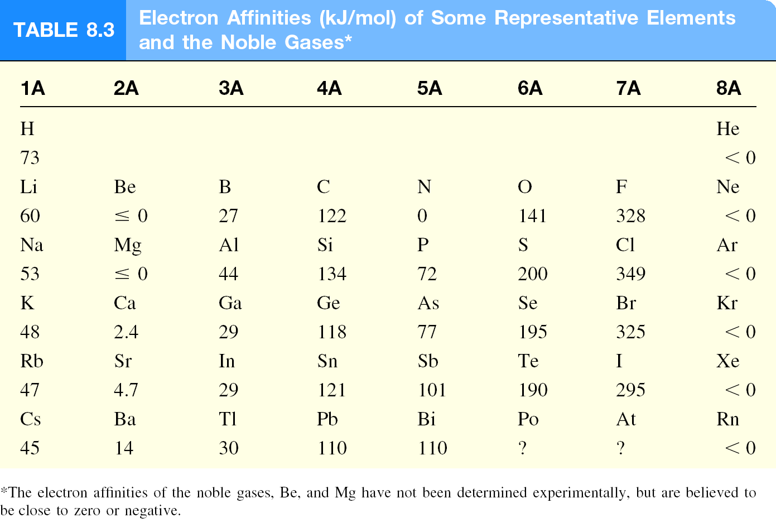
Electron Affinity
Electron Affinities (kJ/mol) of some representative elements
and the Noble Gases*

Slide 41
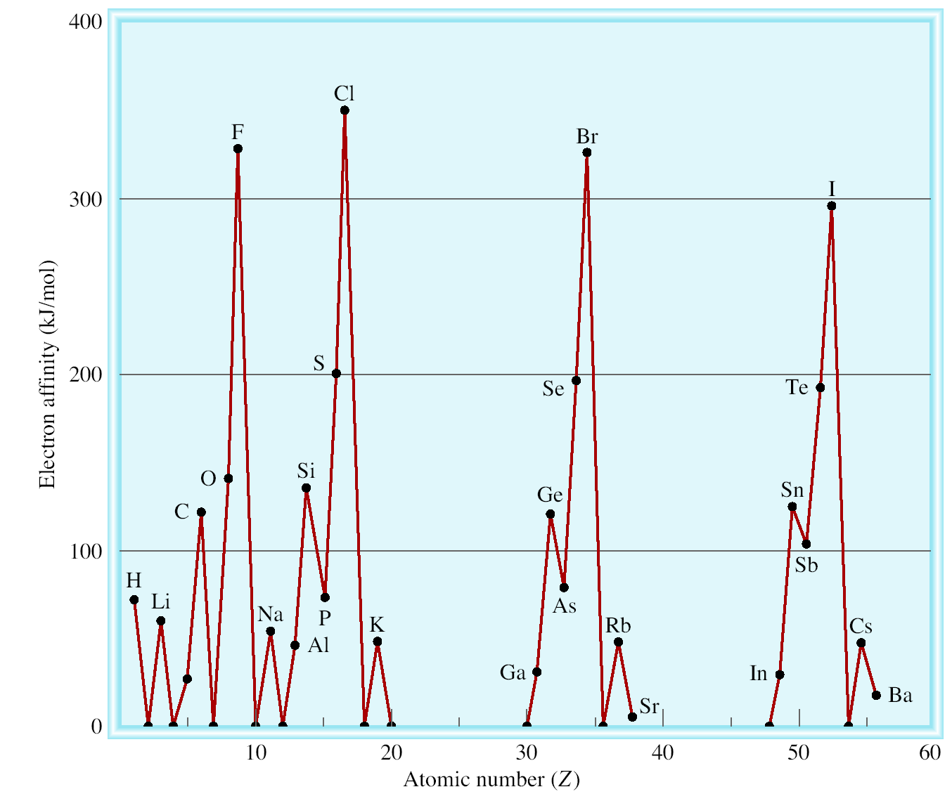
Electron Affinity vs Atomic Number

Slide 42
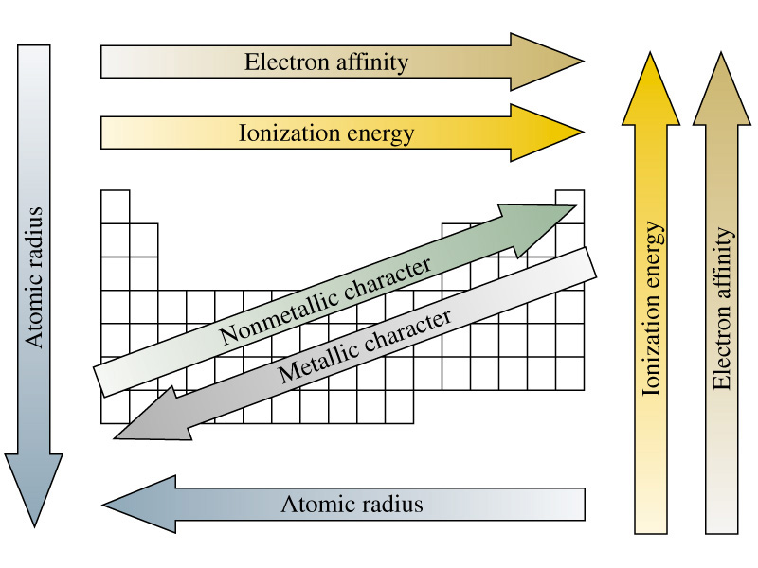
Periodic Properties of the Elements
Notes:
Metallic character corresponds to conductance of heat and electricity.

Slide 43
Variation in Chemical Properties of the Representative Elements
Ionization energy (IE) and electron affinity (EA) help us to understand:
the types of reactions an element undergo
the nature of the elements’ compounds formed
IE measures the attraction of an atom for its own electrons
EA expresses the attraction of an atom for additional electrons
IE and EA together gives the insight into the general attraction of an atom for electron
With these concepts we can survey the chemical behavior of the elements systematically.

Slide 44
Variation in Chemical Properties of the Representative Elements
The metallic character of the elements
decreases from left to right across a period, and
increases from top to bottom within a group
Metals usually have low ionization energies, and Nonmetals usually have high electron affinity
On the basis of these trends we can predict the outcome of a reaction involving some of these elements

Slide 45
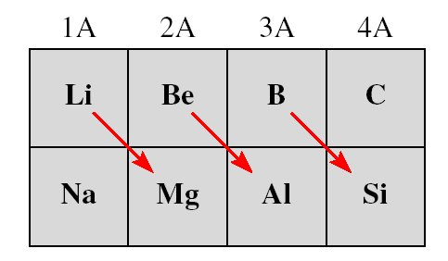
General Trends in Chemical Properties
Diagonal Relationships on the Periodic Table

Slide 46
Hydrogen (1s¹)
No suitable position for hydrogen in the periodic table, it really could be a class by itself
Like alkali metals, has a single s electron and forms H⁺ ion, which is hydrated in solution (H₃O⁺)
Also forms hydride ion H⁻ in ionic compounds, NaH, CaH₂
Hydrides reacts with water:
2NaH(s) + 2H₂O(l) → 2NaOH(aq) + H₂(g)
CaH₂(s) + 2H₂O(l) → Ca(OH)₂(s) + 2H₂(g)
Most important compound of hydrogen is water,
2H₂(g) + O₂(g) → 2H₂O(l)

Slide 47
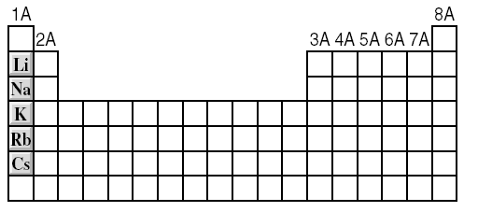
Group 1A Elements (ns¹, n ≥ 2)
M M⁺¹ + 1e⁻
So reactive, never found in pure state in nature.
2M_{(s)} + 2H₂O_{(l)} 2MOH_{(aq)} + H_{2(g)}
Increasing reactivity

Slide 48
Group 1A Elements (ns¹, n ≥ 2)
In air lose shiny appearance by combining with O₂ to form oxides:
Li forms oxides
Na, K, Rb, & Cs forms oxides and peroxides
K, Rb, & Cs also forms superoxides
Stability of oxides depends on how strongly the cations and anions attracts one another in the solid states
4Li_{(s)} + O_{2(g)} 2Li₂O_{(s)}; Lithium oxide, contg. O²⁻
2Na_{(s)} + O_{2(g)} Na₂O_{2(s)}; peroxide, contg. O₂²⁻
K_{(s)} + O_{2(g)} KO_{2(s)}; superoxide, contg. O₂⁻

Slide 49
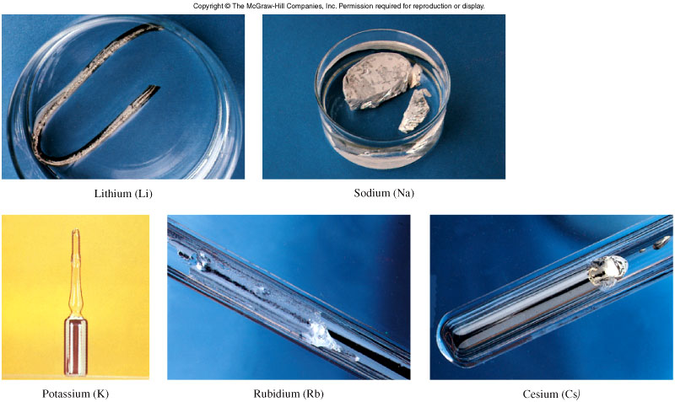
Group 1A Elements (ns¹, n ≥ 2)

Slide 50
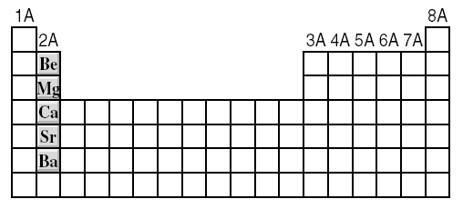
Group 2A Elements (ns², n ≥ 2)
M M⁺² + 2e⁻
Be_{(s)} + 2H₂O_{(l)} No Reaction
Mg_{(s)} + 2H₂O_{(g)} Mg(OH)_{2(aq)} + H_{2(g)}
M_{(s)} + 2H₂O_{(l)} M(OH)_{2(aq)} + H_{2(g)} M = Ca, Sr, or Ba
Increasing reactivity

Slide 51
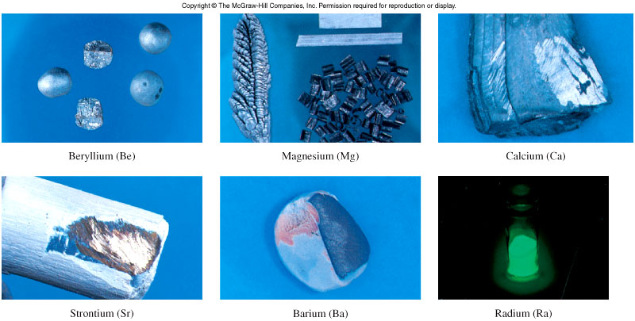
Group 2A Elements (ns², n ≥ 2)

Slide 52
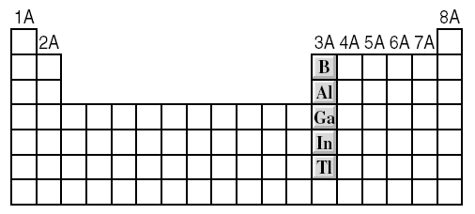
Group 3A Elements (ns²np¹, n ≥ 2)
4Al_{(s)} + 3O_{2(g)} 2Al₂O_{3(s)}
2Al_{(s)} + 6H⁺_{(aq)} 2Al³⁺_{(aq)} + 3H_{2(g)}

Slide 53
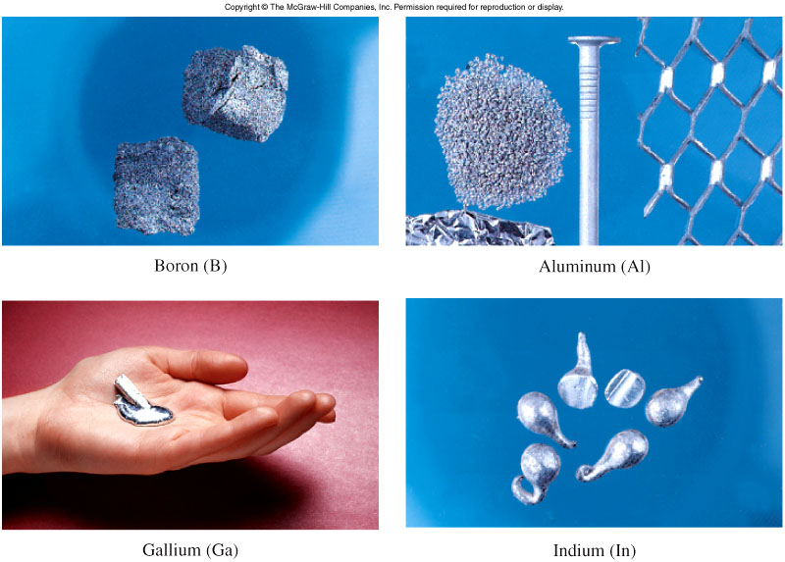
Group 3A Elements (ns²np¹, n ≥ 2)

Slide 54
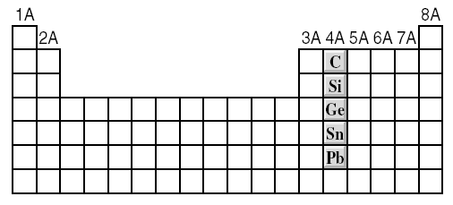
Group 4A Elements (ns²np², n ≥ 2)
Sn_{(s)} + 2H⁺_{(aq)} Sn²⁺_{(aq)} + H₂ _{(g)}
Pb_{(s)} + 2H⁺_{(aq)} Pb²⁺_{(aq)} + H₂ _{(g)}

Slide 55
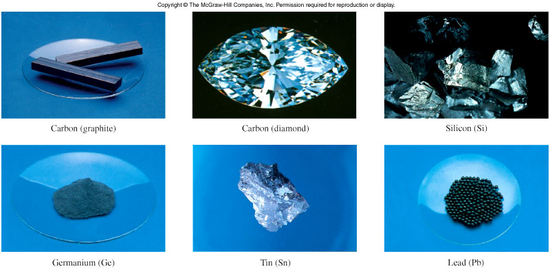
Group 4A Elements (ns²np², n ≥ 2)

Slide 56
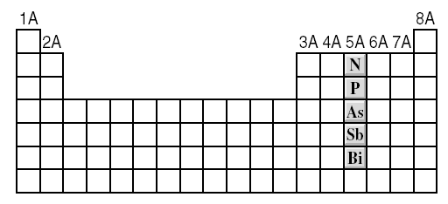
Group 5A Elements (ns²np³, n ≥ 2)
N₂O_{5(s)} + H₂O_{(l)} 2HNO_{3(aq)}
P₄O_{10(s)} + 6H₂O_{(l)} 4H₃PO_{4(aq)}

Slide 57
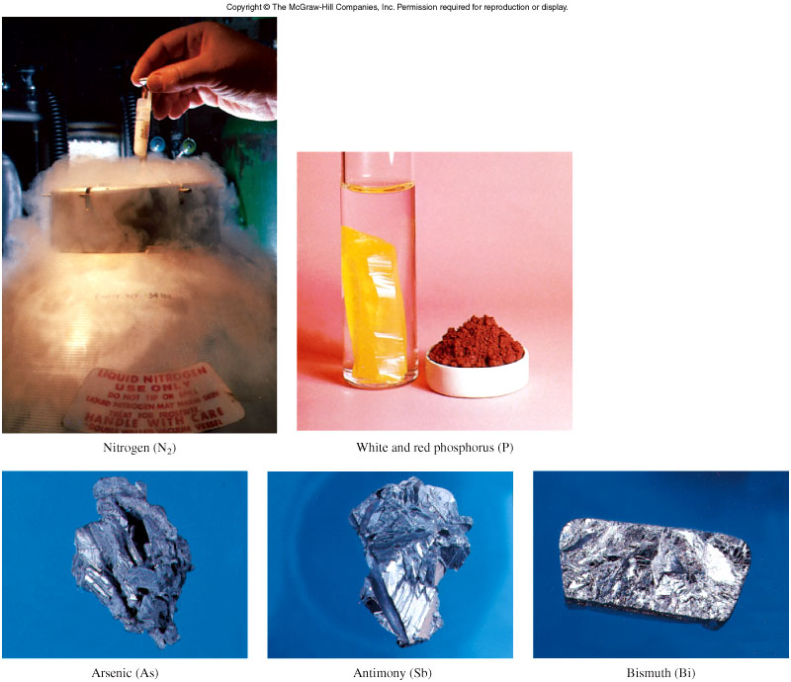
Group 5A Elements (ns²np³, n ≥ 2)

Slide 58
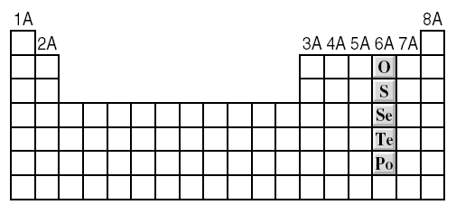
Group 6A Elements (ns²np⁴, n ≥ 2)
SO_{3(g)} + H₂O_{(l)} H₂SO_{4(aq)}

Slide 59
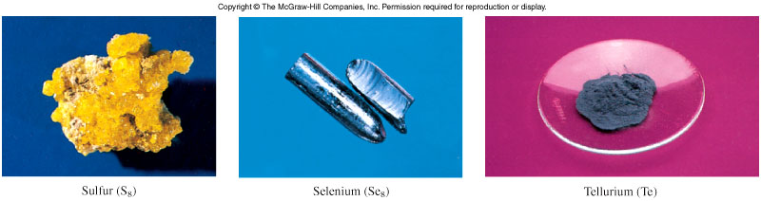
Group 6A Elements (ns²np⁴, n ≥ 2)

Slide 60
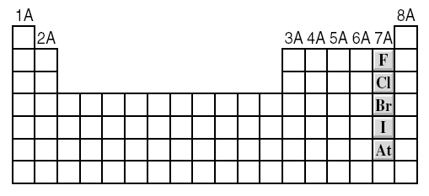
Group 7A Elements (ns²np⁵, n ≥ 2)
X + 1e⁻ X⁻¹
2F_{2(g)} + 2H₂O_{(l)} 4HF_{(aq)} + O_{2(g)}
X_{2(g)} + H_{2(g)} 2HX_{(g)}
Increasing reactivity

Slide 61
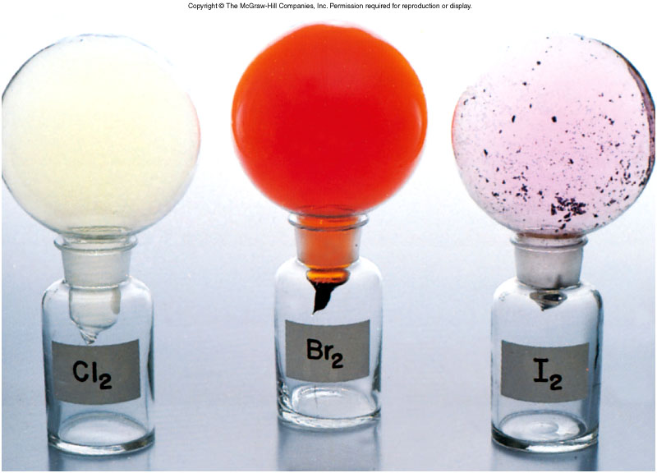
Group 7A Elements (ns²np⁵, n ≥ 2)

Slide 62
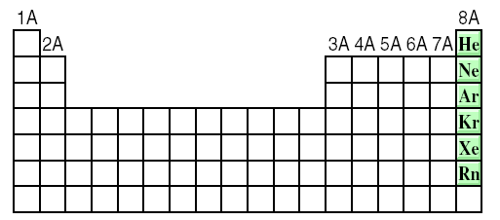
Group 8A Elements (ns²np⁶, n ≥ 2)
Completely filled ns and np subshells.
Highest ionization energy of all elements.
No tendency to accept extra electrons.

Slide 63
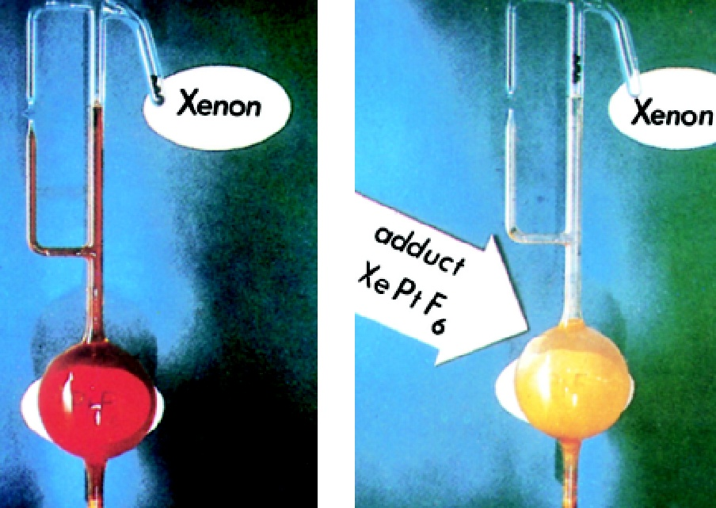
Compounds of the Noble Gases
A number of xenon compounds XeF₄, XeO₃, XeO₄, XeOF₄ exist.
A few krypton compounds (KrF₂, for example) have been prepared.

Slide 64
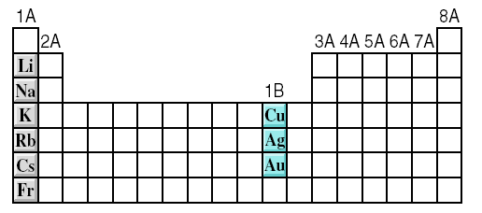
Comparison of Group 1A and 1B
The metals in these two groups have similar outer electron configurations, with one electron in the outermost s orbital
Chemical properties are quite different due to difference in the ionization energy.
Lower I₁, more reactive

Slide 65
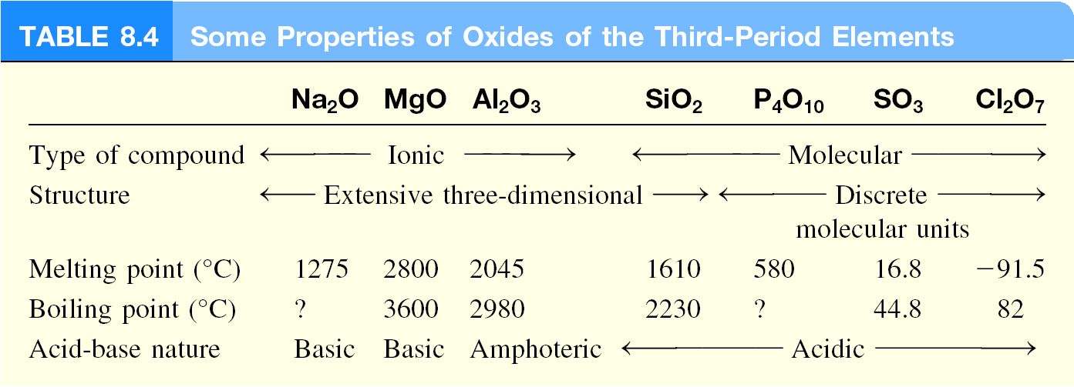
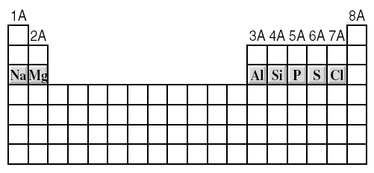
Properties of Oxides Across a Period
basic
acidic

Slide 66
Properties of Oxides Across a Period
Basic oxides:
Na₂O and MgO are basic oxides,
Na₂O(s) + H₂O(l) → 2NaOH(aq)
MgO(s) + 2HCl(aq) → MgCl₂(aq) + H₂O(l)
Amphoteric oxide:
Al₂O₃ is an amphoteric oxide,
Al₂O₃(s) + 6HCl(aq) → 2AlCl₃(aq) + 3H₂O(l)
Al₂O₃(s) + 2NaOH(aq) + 3H₂O(l) → 2NaAl(OH)₄(aq)
Other amphoteric oxides are, ZnO, BeO, and Bi₂O₃

Slide 67
Properties of Oxides Across a Period
Acidic oxides:
SiO₂, P₄O₁₀, SO₃ and Cl₂O₇ are acidic oxides,
SiO₂(s) + 2NaOH(aq) → Na₂SiO₃(aq) + H₂O(l)
P₄O₁₀(s) + 6H₂O(l) → 4H₃PO₄(aq)
SO₃(g) + H₂O(l) → H₂SO₄(aq)
Cl₂O₇(l) + H₂O(l) → 2HClO₄(aq)
Neutral oxides:
Some oxides are neutral, CO and NO, Do not react with water to produce acidic or basic solution

Slide 68
Thank you

